Slide 1
GEOGRAPHY AND TIMESTAMP OF SPAM TWEETS(Determining the type of tweets, location, datetime, Positive and Negative tweets)
Group 7 Team Members:
Mounika Nuchu
Anitha Nari
Monisha Mahitha boddu
Vijayalakshmi Peppala

Slide 2
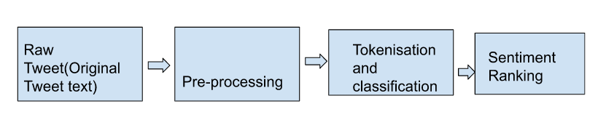
Workflow

Slide 3
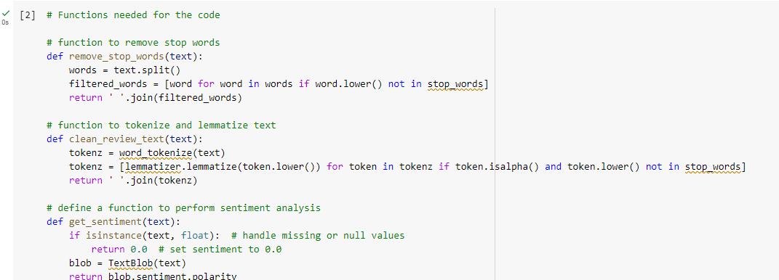
Functions for code, tokenize, sentiment Analysis

Slide 4
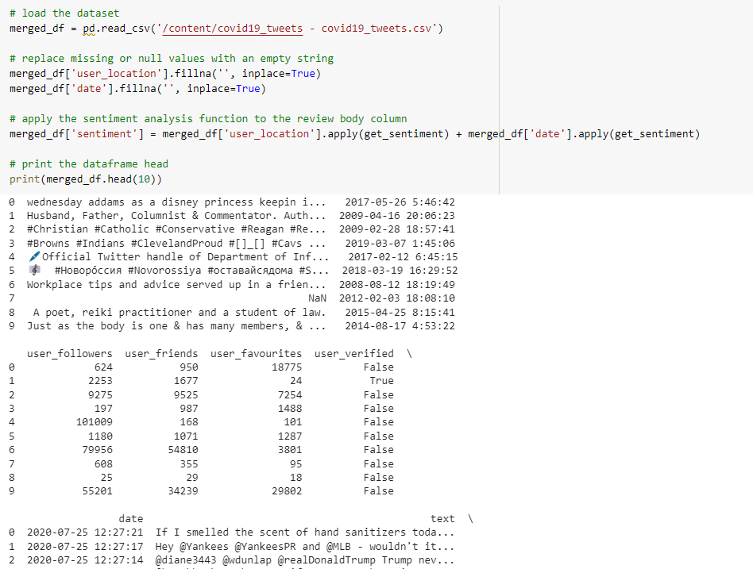
Loading of Dataset

Slide 5
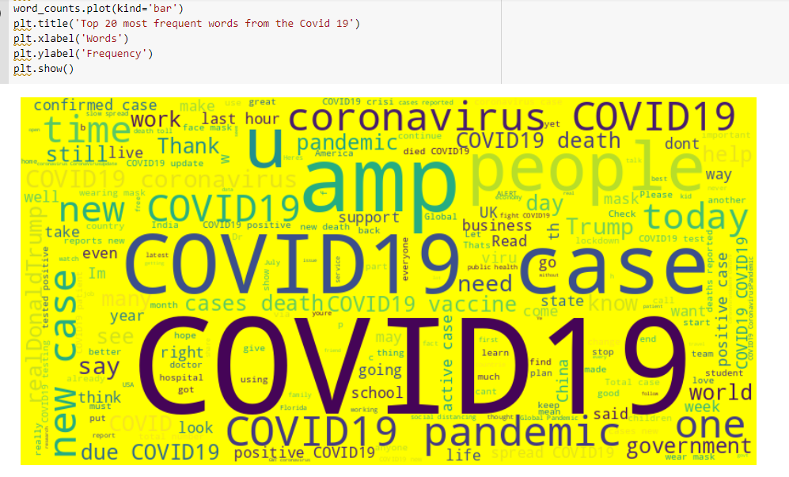
Cleaning of tweets for further analysis and generating cloud

Slide 6
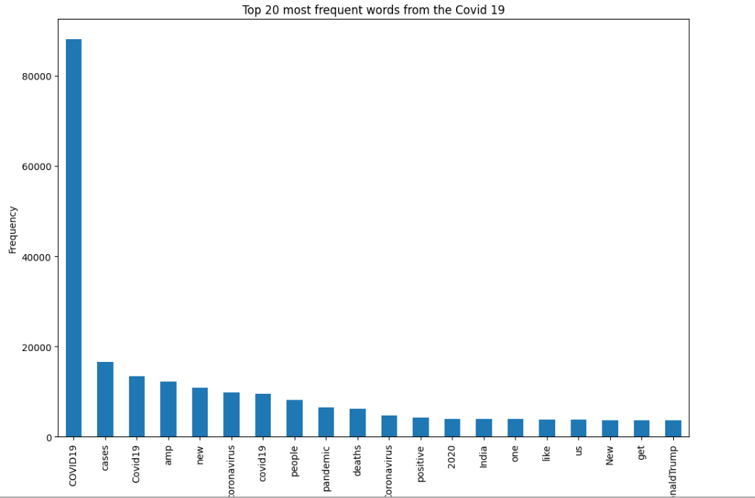
Generating Bar graph

Slide 7
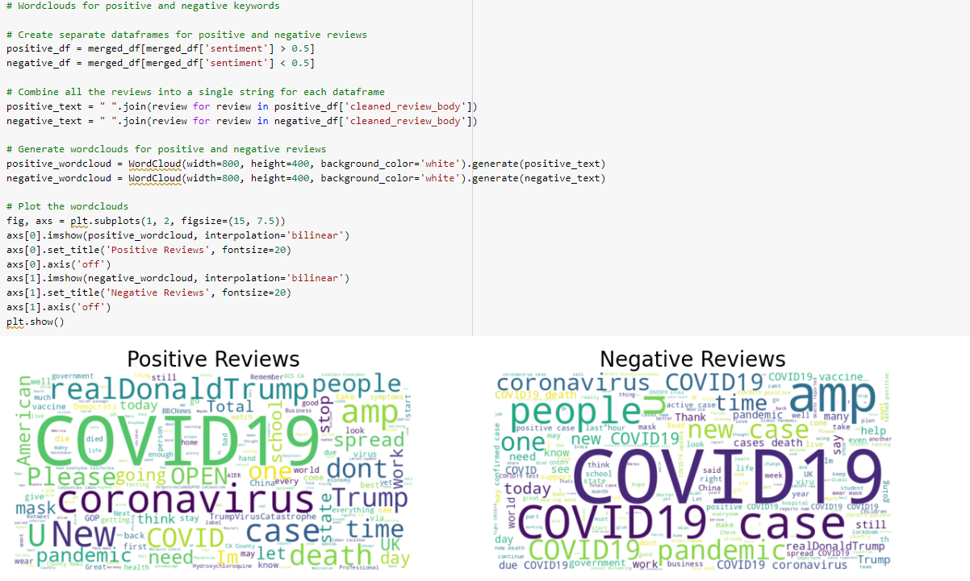
Positive and negative tweets

Slide 8
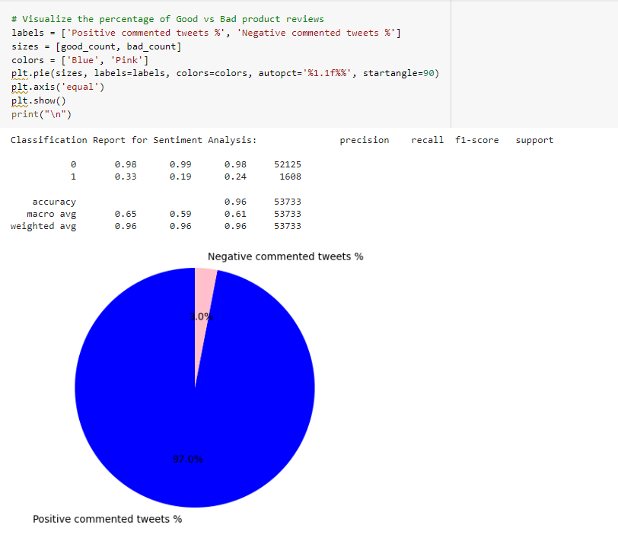
Generating Positive and negative tweets in Pie chart

Slide 9
Features
A context-dependent sentiment classifier by combining the sentiment analysis of various authors, user locations, user timestamp, and dates
as determined by tagged Data collected from Twitter with conventional based on words sentiment different methods of classification.
The most important features extracted from the dataset are:
• Text: The actual text of the tweet.
• User Location: The location of the user who tweeted.
• Sentiment: The sentiment score of the tweet.

Slide 10
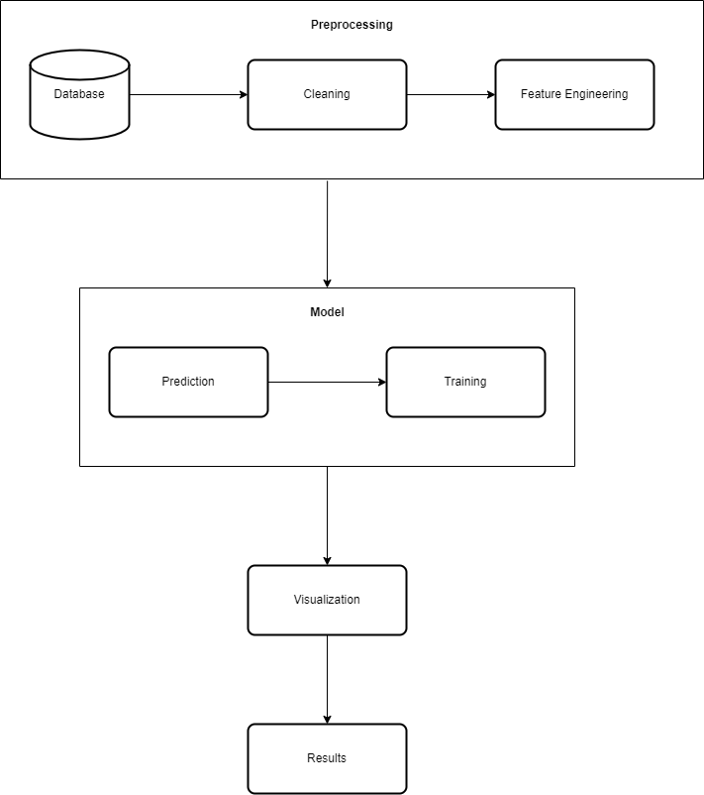
Architecture

Slide 11
The architectural design comprises of three primary constituents, namely Preprocessing, Model, and Postprocessing.
The Preprocessing module retrieves tweets and associated metadata from a database and subsequently transmits them to the Cleaning component for the purpose of performing cleaning and transformation operations.
The Model component receives the preprocessed data and generates a model by training it with diverse algorithms.
The Postprocessing module is responsible for producing visual representations through the utilization of diverse plots and charts based on the predictions.

Slide 12
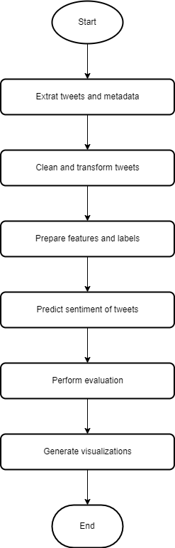
WorkFlow Diagram

Slide 13
The workflow commences with the User initiating a query to retrieve tweets and associated metadata from the database.
The tweets and associated metadata are extracted from the database and subsequently forwarded to the Cleaning module for the purpose of cleaning and transformation.
The data that has been cleaned and transformed is subsequently transmitted to the Feature Engineering module, where features and labels are prepared for the purpose of training.
The features and labels that have been prepared are subsequently transferred to the Training module, where a model is trained utilizing diverse algorithms.

Slide 14
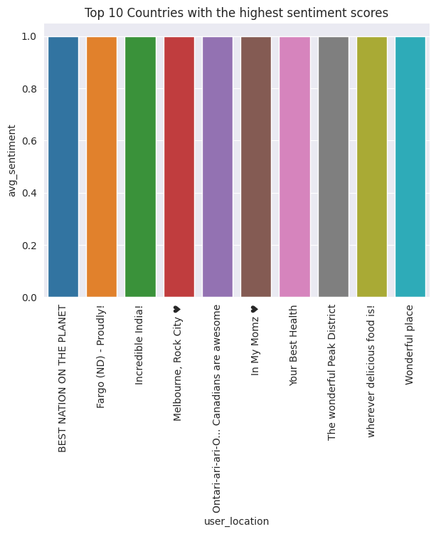
Plot of top 10 locations with highest sentiment scores

Slide 15
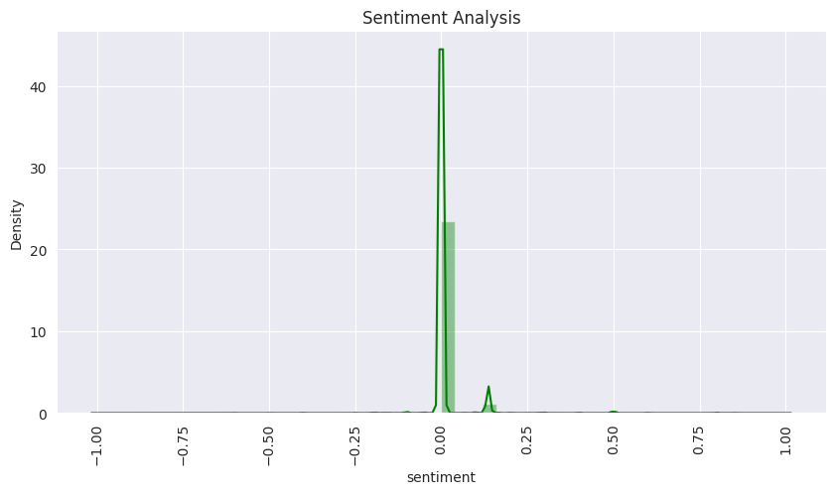

Slide 16
An interesting observation was made when analyzing the sentiment based on whether the user was verified or not. It was found that for unverified users (0), the average sentiment was closer to zero than for verified users as can be seen.

Slide 17
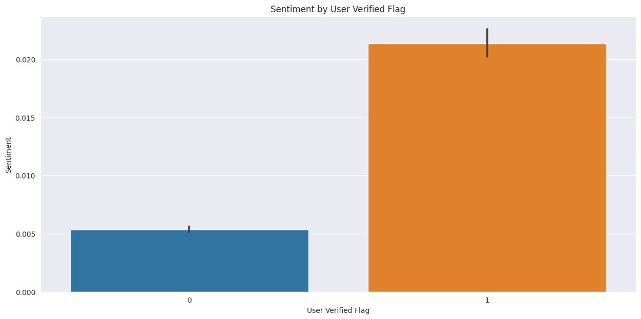

Slide 18
Other interesting observations were made when analyzing the sentiment value and the review length.
For this observation, it was found out that the longer the length of the review, the higher the sentiment value.

Slide 19
Thank You

